Slide 1


Slide 2
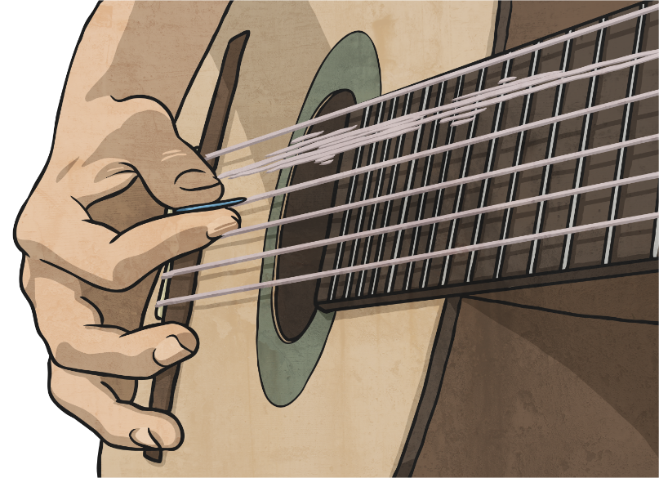
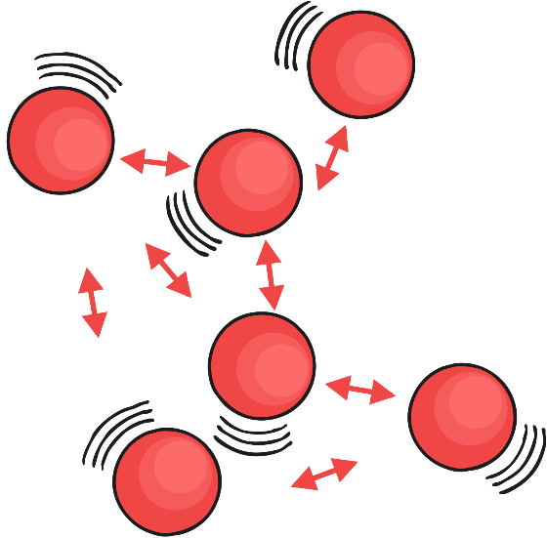
How Sound Is Made
Like light, sound travels through the air in waves.
Sound is made by air molecules vibrating.
When you clap your hands, the air around your hands shakes.
This is the air molecules vibrating.
Meaning
Vibrating – shake quickly back
and forth.

Slide 3
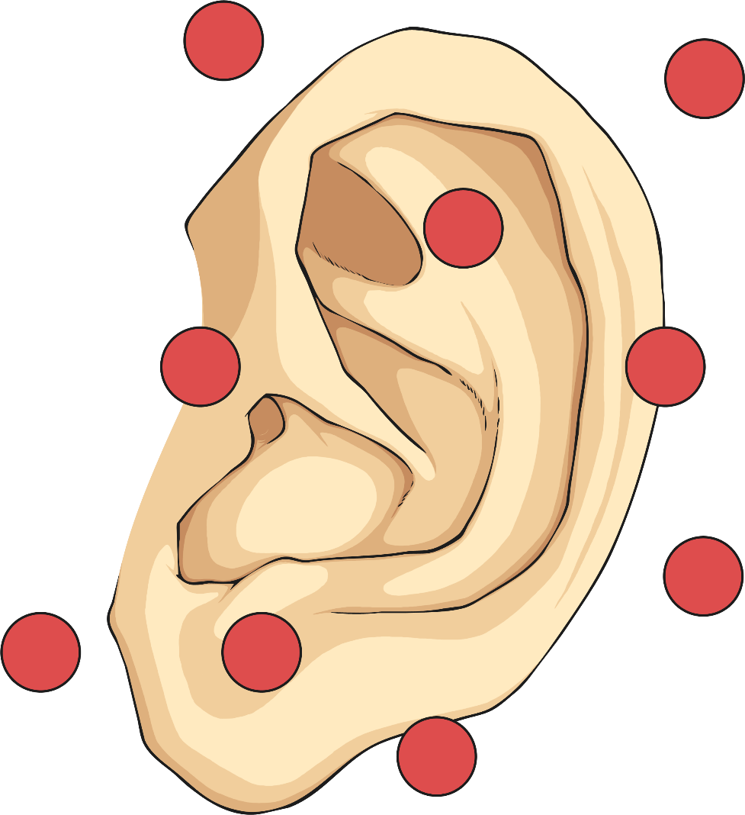

How Sound Is Made
The vibration of the air molecules around the clapped hands shake the molecules around them. The molecules continue to shake the molecules next to them until
the air molecules in the ears
are vibrating.
Have you ever felt a speaker when the sound is on?
It vibrates!

Slide 4
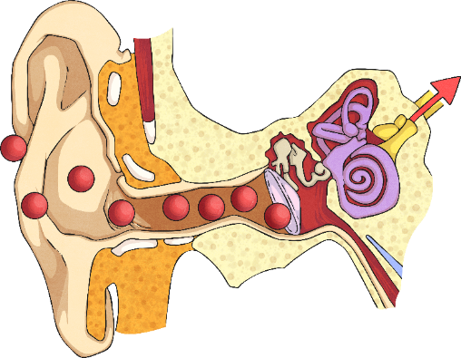
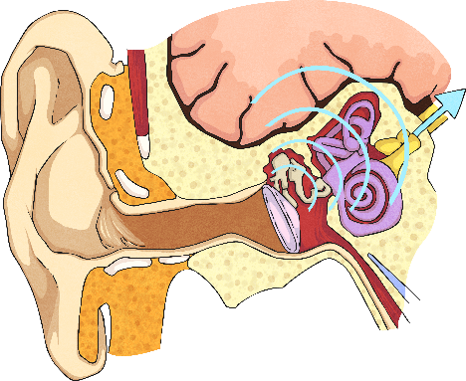
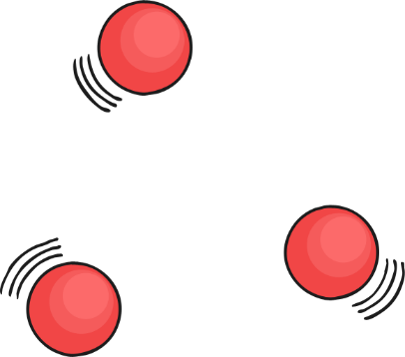
How Sound Is Made
When air molecules inside the ears vibrate, they shake tiny hairs on the insides of the ears.
The hairs are connected to nerves under the skin.
Molecules Vibrating
These nerves send messages to your brain to tell you that you heard
a noise.
Communicating With the Brain

Slide 5

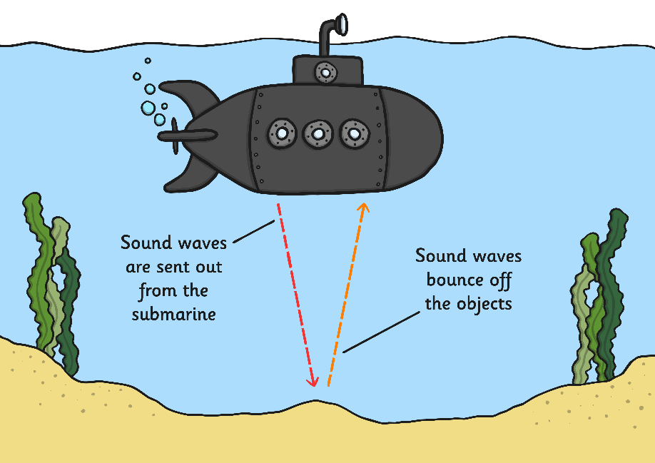
How Sound Is Made
Sound needs molecules to move. It is impossible for sound to travel
in space.
Sound doesn’t have to move through air. It can travel through water or metal.
In fact, sound travels faster through water and solids than it does through air.

Slide 6
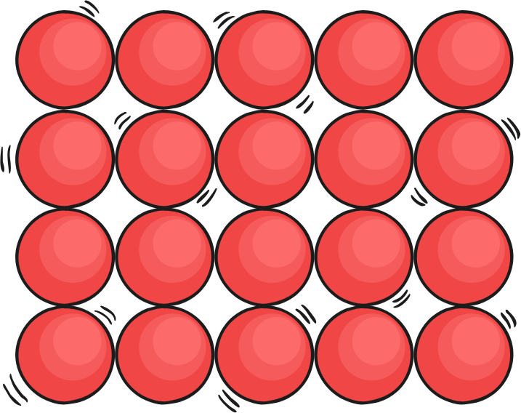
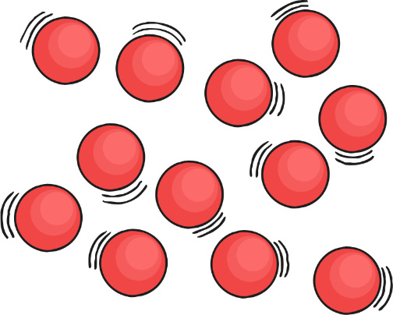
How Sound Is Made
Why do you think sound travels faster through solids
and liquids, than gases?
Solid
Hint
Think about how close the molecules are to each other.
Liquid

Slide 7


